Slide 1

Twisting Fate
Team: Conclusion’s Dissolutions By: Cep, Tenise, Bastien, LoukasDri, DSingh, C.Sam (And More!)

Slide 2
Summary
Follow the Last Human’s Consciousness being Guided by F.A.T.E. to relive the Disasters that Destroyed humanity, while building the perspective to determine if Humanity Should Live Again.

Slide 3
Filling our Goal
Reflects personal choices through puzzles
Through platforming, exploring and observation puzzles
Story has a strong emotional impact

Slide 4
The Impact
A thought-provoking experience based on the current state of the world.
This gameplay encourages the player to pose questions to themselves.
Challenges the player to change their own world perspective.

Slide 5
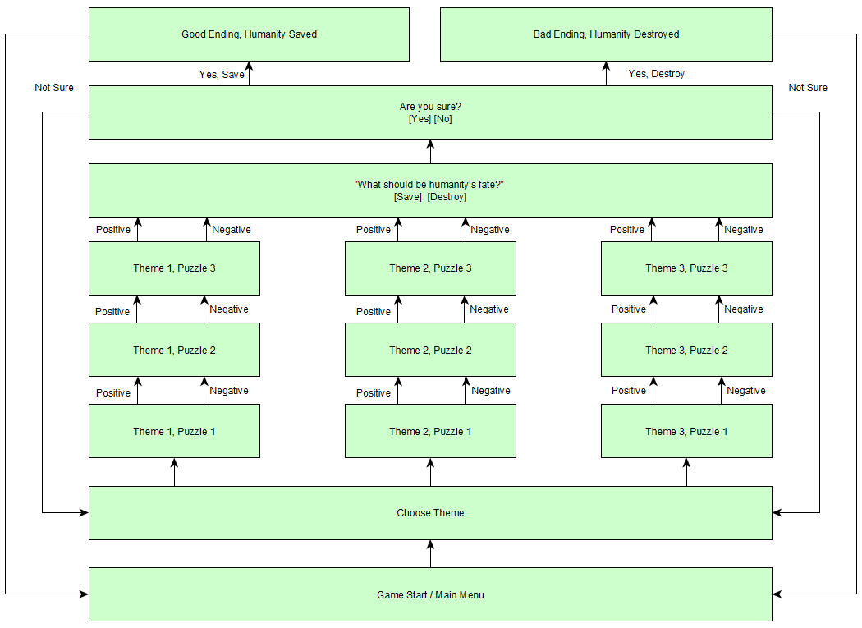
Game Loop

Slide 6
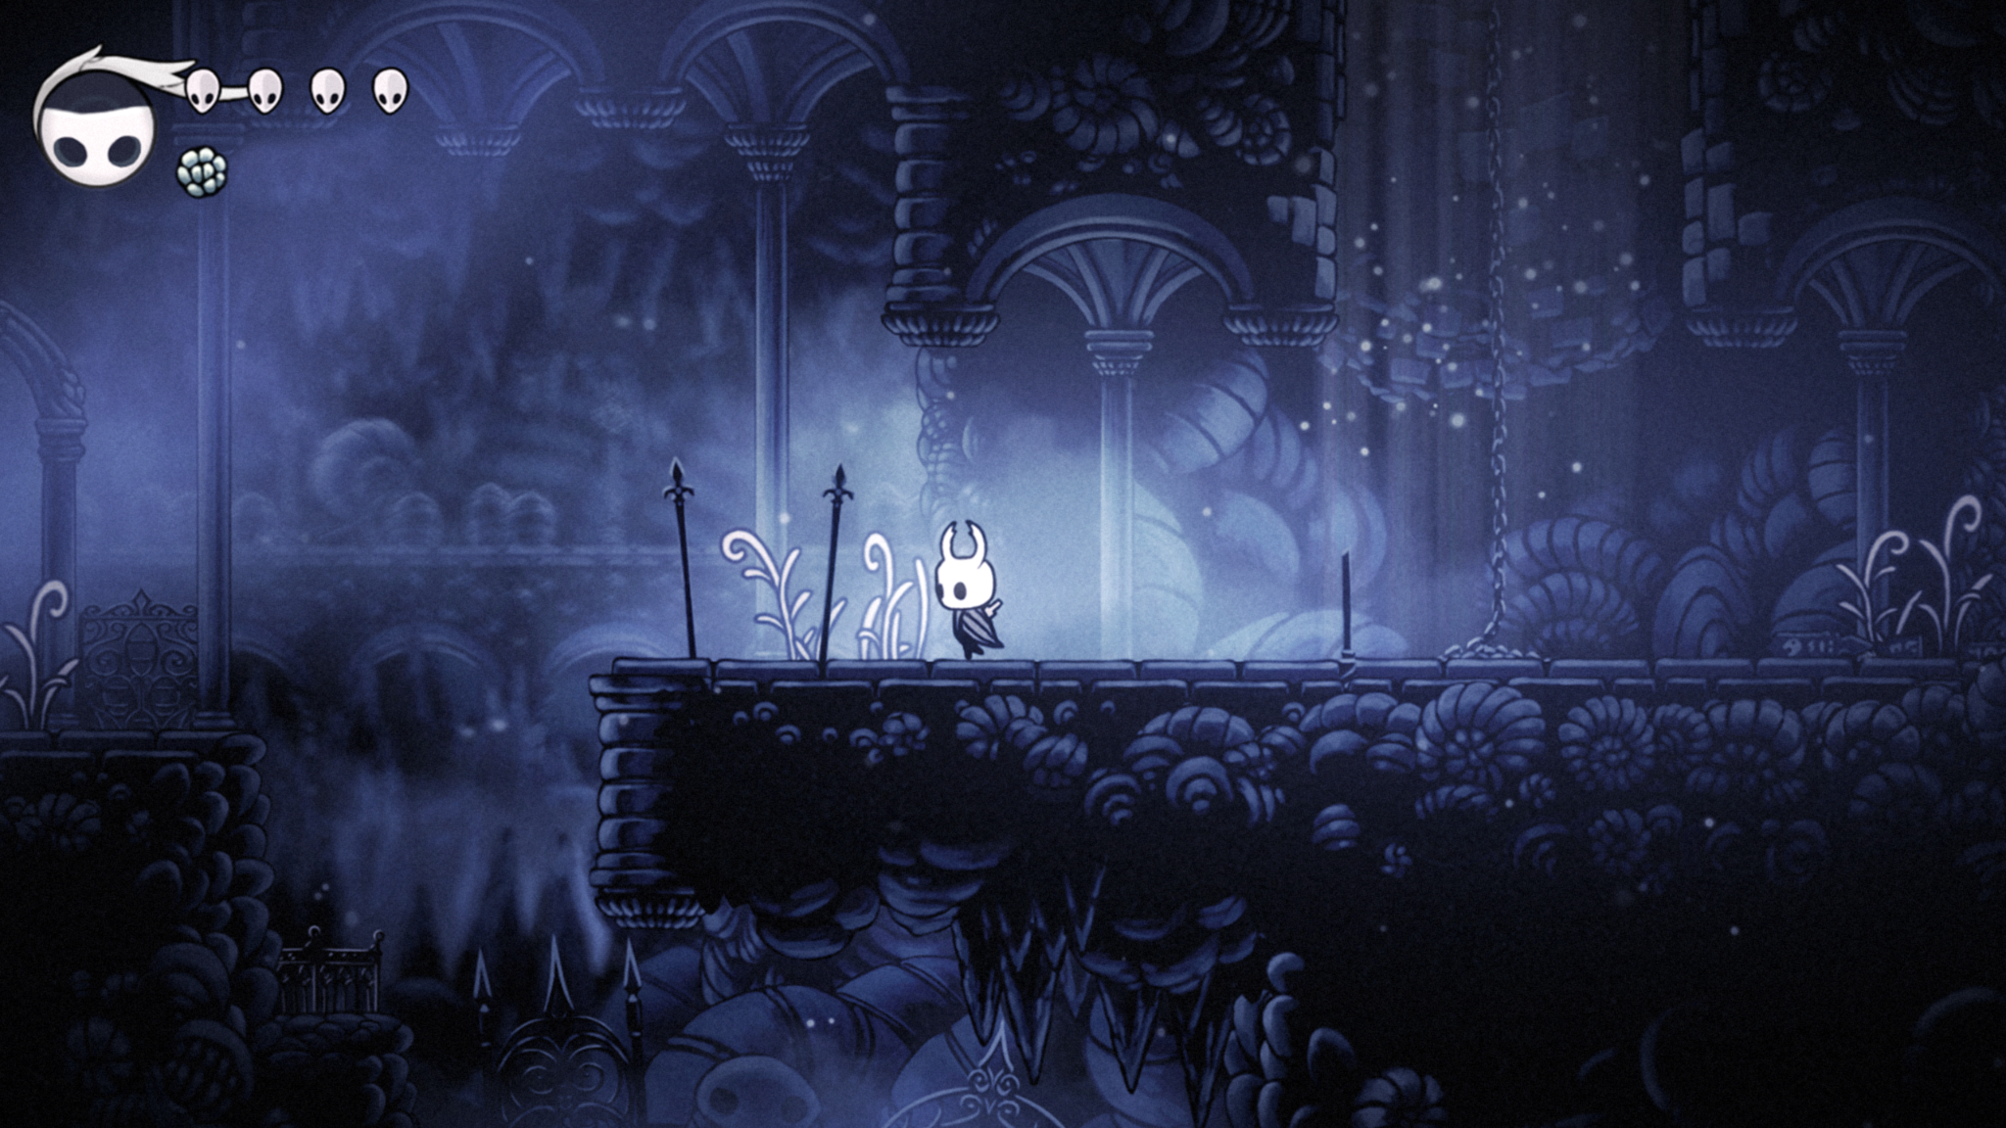
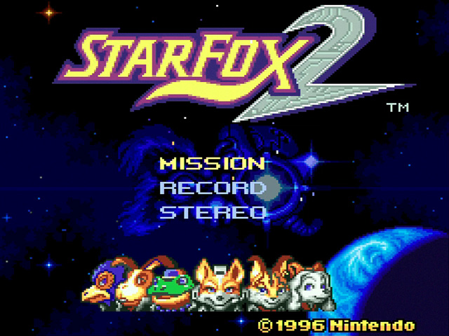
The Art Style
2D Art
Darker Black, Blue, White and Grey
Colors Gradually Change
Solid Backgrounds

Slide 7


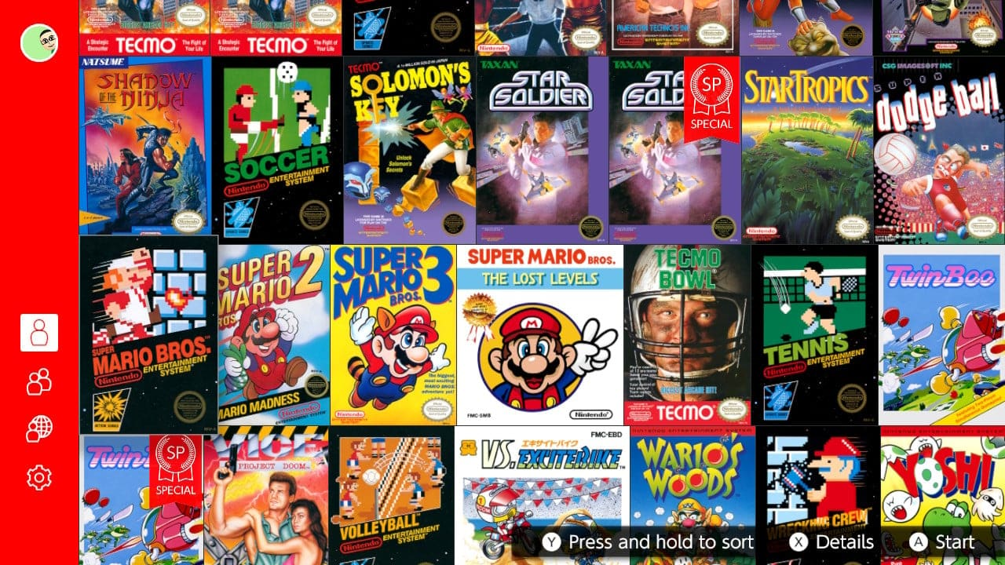
Target Audience

